Slide 1
Ehsaas
Making world a better place

Slide 2

Co-Supervisor
Group Members
Ammar Ullah Khan (19K-1435)
Muhammad Maaz (19K-0148)
Mir Saad Ali (19K-0133)
Supervisor
Mr. Basit Jasani
Engr. Syed Zain ul hassan

Slide 3
Project Overview
Our developed solution features an automated workflow system with key functionalities such as Ambulance Service, Blood Donations, and Missing Persons. In the event of an ambulance request, users with available cars within the caller's radius will receive a notification and will be prompted to accept the ride. Similarly, in the case of a need for O+ve blood group, users with the matching blood type within the hospital's radius will receive a notification and will be asked to donate. To expedite the process, searching algorithms and Google Maps will be utilized, reducing response times and guiding users to their destination. For missing persons, individuals in the surrounding area will be alerted, and computer vision technology will be used to match the missing person's face with anyone who has also been reported missing. Upon completion of the request, users will receive a notification and the request will be closed. An admin panel is developed to track the trajectory of different requests, enabling us to plan and allocate resources efficiently for future use.

Slide 4
Implemented Features
FOR END USER PORTAL
Registration
Log in
Blood Request
Ambulance Request
Missing Person/Unknown person
Account Settings
News Feed
Admin Portal
Manage Users
Graph UI
Manage Requests

Slide 5
Technologies
Frontend
HTML, CSS, JavaScript, React JS, NIVO Charts, MUi
Backend
NodeJS, Express JS
Database
MongoDB
Tool
GitHub, android studio, VS code

Slide 6
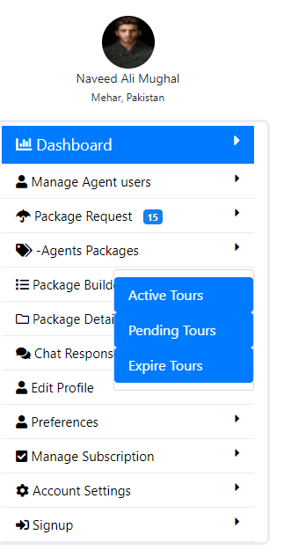
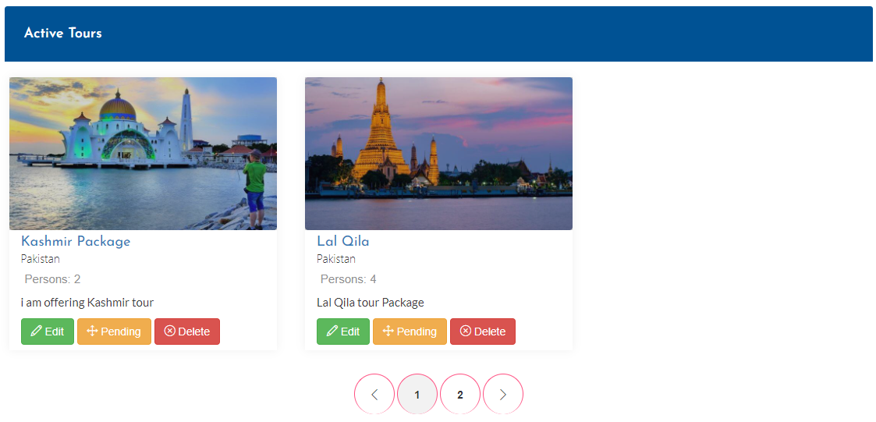
Agent Packages Status

Slide 7
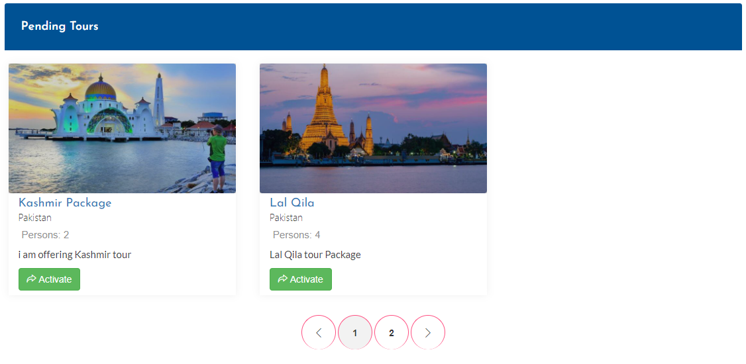
Agent Packages Status

Slide 8

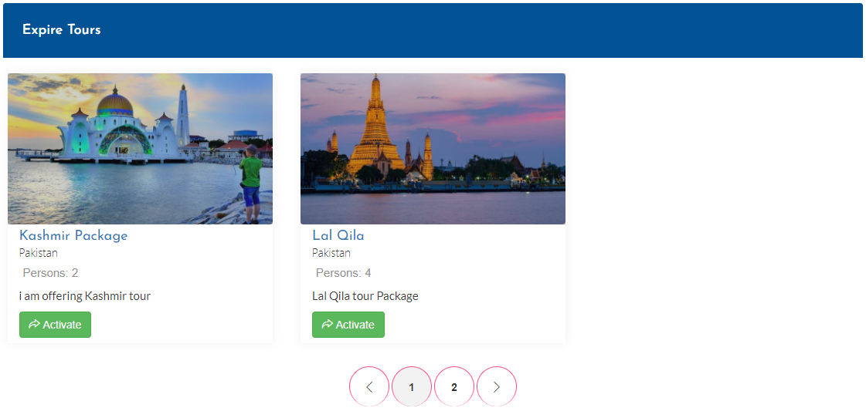
Agent Packages Status

Slide 9
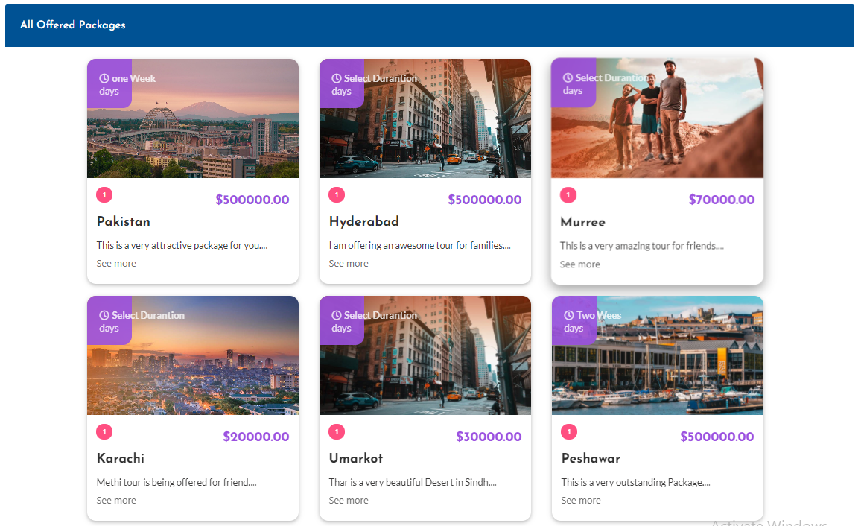
Packages Details

Slide 10
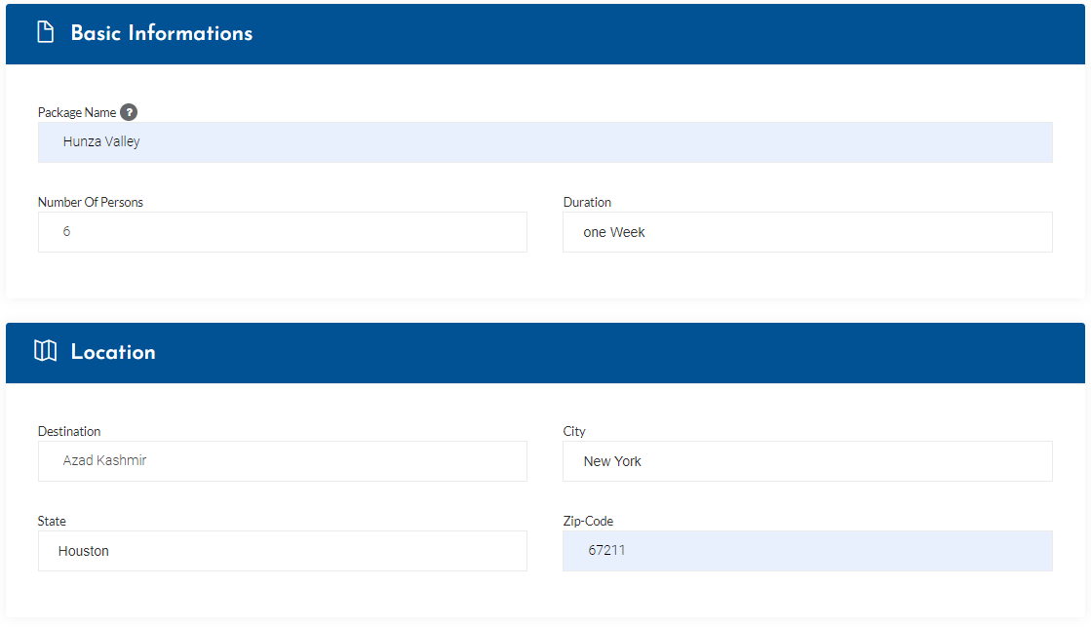
Package Builder

Slide 11
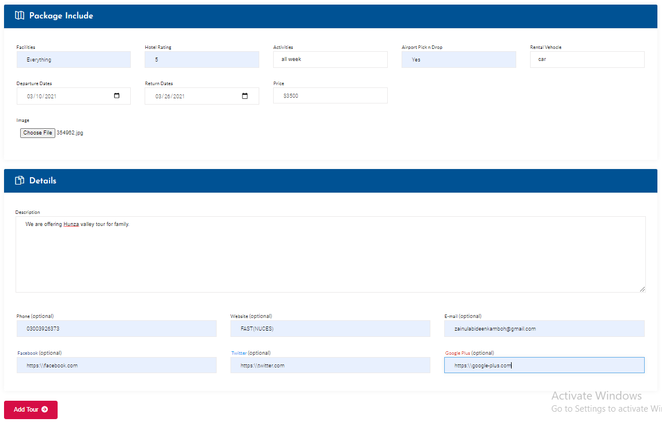
Package Builder

Slide 12
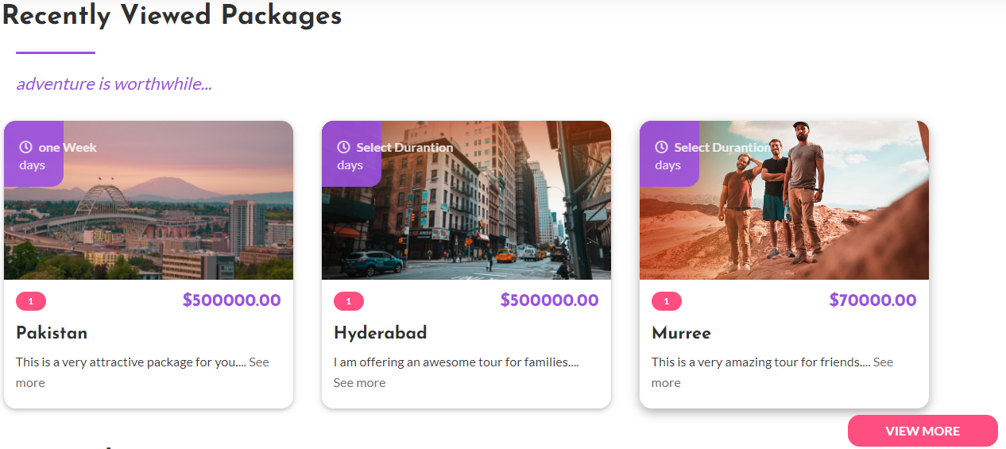
Package Types

Slide 13
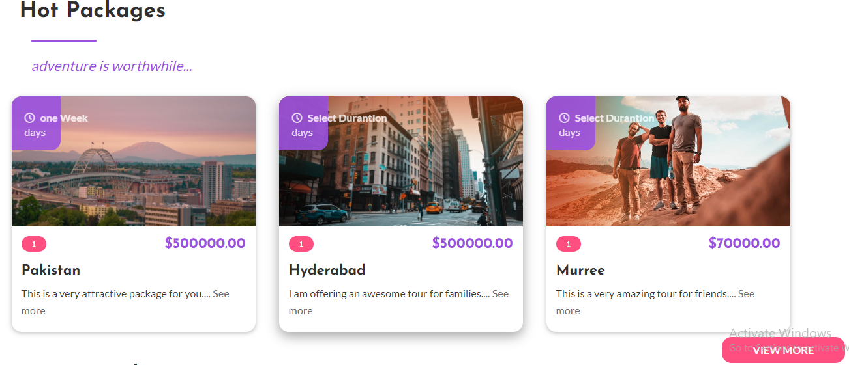
Package Types

Slide 14
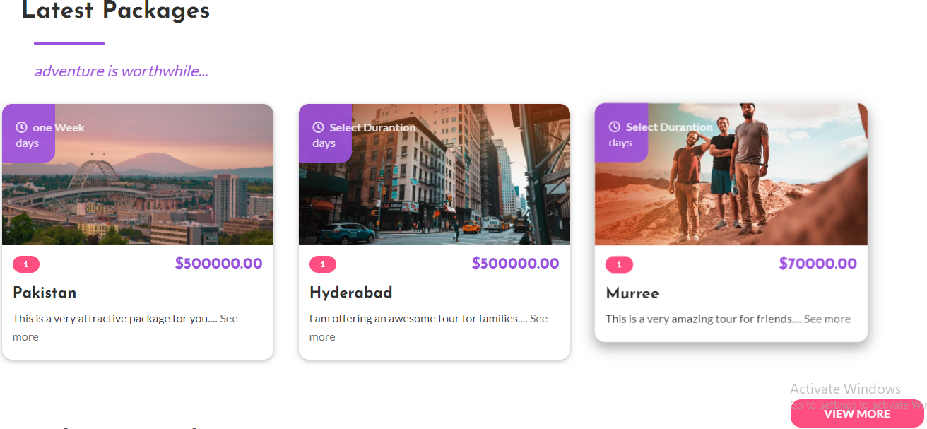
Package Types

Slide 15
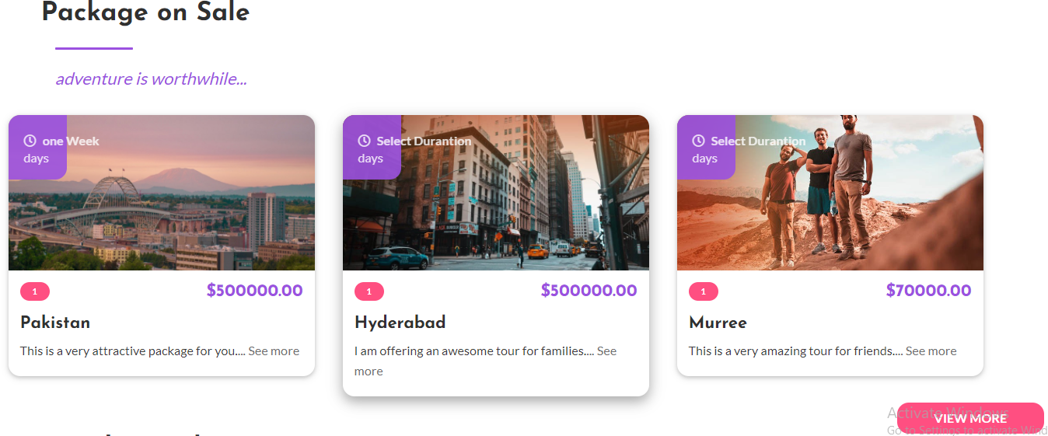
Package Types

Slide 16
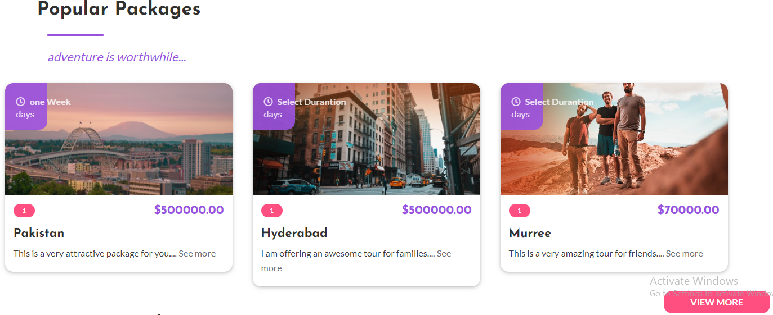
Package Types

Slide 17
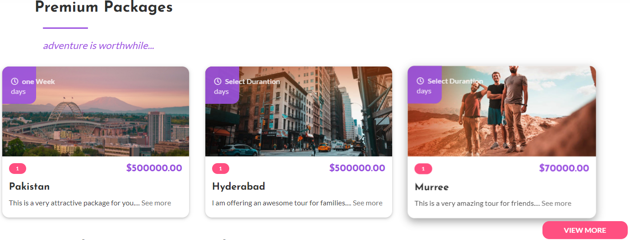
Package Types

Slide 18
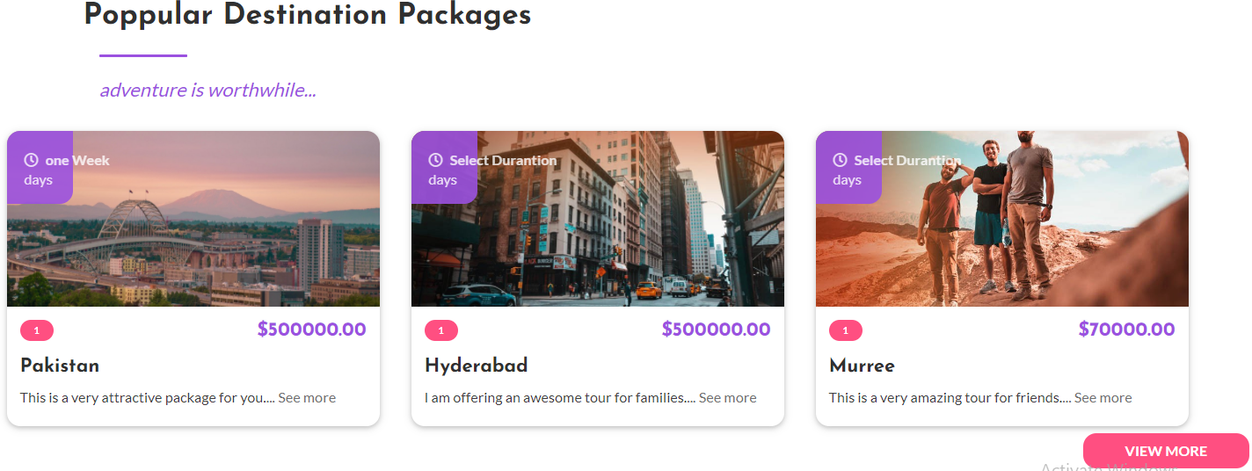
Package Types

Slide 19
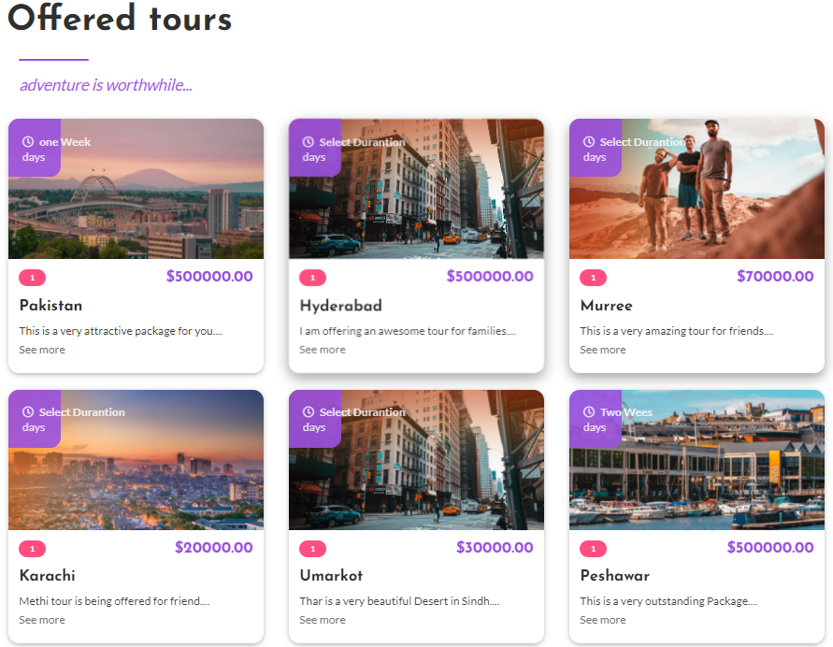
Package Types

Slide 20
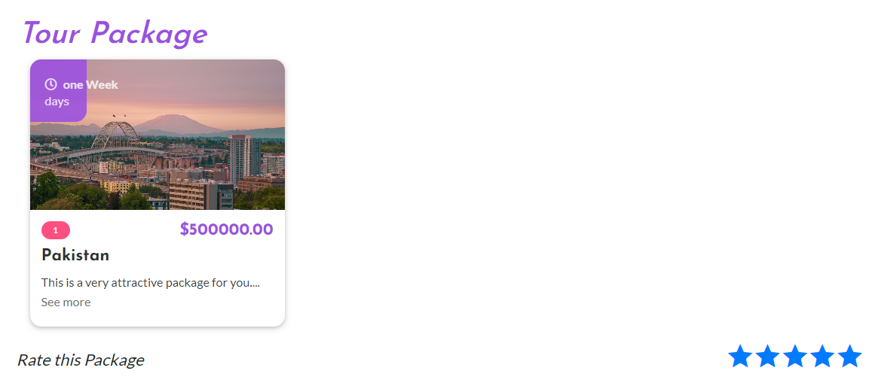
Package Review/Comments

Slide 21
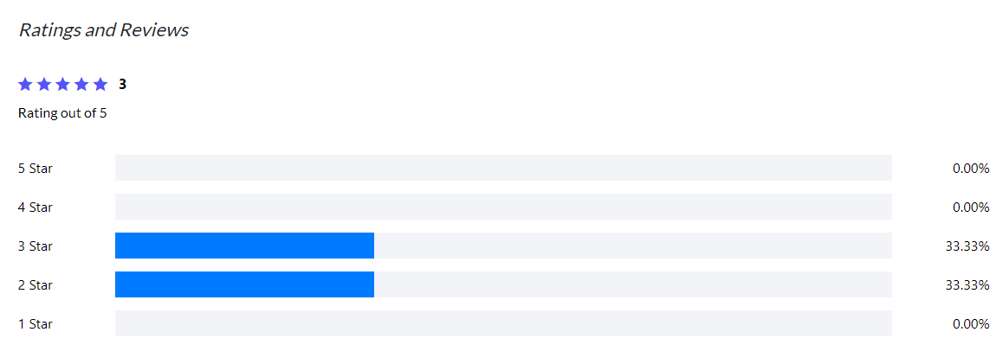
Package Review/Comments

Slide 22
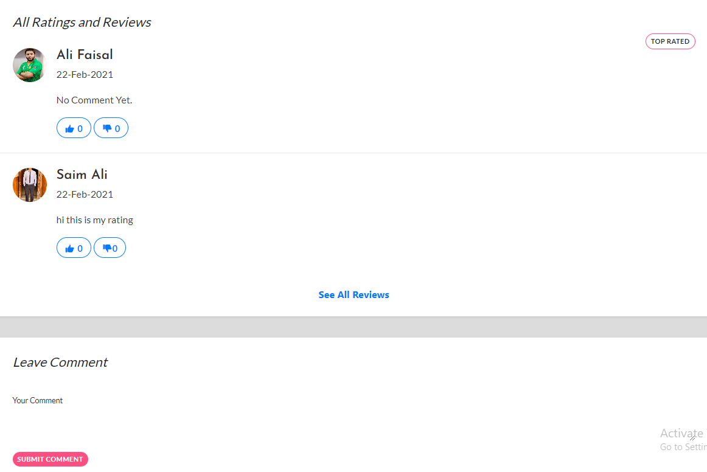
Package Review/Comments

Slide 23
FYP-II Milestone
Complete Request Package feature
Complete Smart search feature
Different types of More Tours e.i Hot tours
Complete Request Package Notification
Complete Chat-Box communication

Slide 24
Timeline
Date | Module Implementation
15-April-2021 | Smart Search
12-May-2021 | Package Request Flow
25-May-2021 | Tours Types
10-June-2021 | Features Testing

Slide 25
Thank You!

